Slide 1

Department of Computer Science and Business Systems
Detection of Forged Signatures using Computer Vision
PROJECT GUIDE:
Dr. P. Tamil Selvi
TEAM MEMBERS:
201401010 - Barath Keshav S 201401011 - Charanya C
Notes:
‹#›

Slide 2
Problem Statement
Project aims to address the issue of signature fraud in various domains in our everyday lives.
Signature forgery poses a significant threat to financial institutions, legal agreements, and personal identities.
There are substantial risks to individuals and organisations, leading to financial losses, legal complications and so many more problems.
Urgent need to protect the integrity of signatures in both physical and digital environments.
In the age of digital transformation, the demand for automated, accurate signature validation is growing rapidly.
This project is motivated by the need to combat fraud, particularly in financial, legal, and identity-related contexts.
Project Review
‹#›

Slide 3
Objectives
to increase the probability of detection of forged signatures
to reduce dependency on human expertise
to increase the security in banking transactions, government processes, official proceedings, etc.
to improve the verification methods currently in use
Project Review
‹#›

Slide 4
Literature Survey
Literature Survey Excel sheet
Project Review
‹#›

Slide 5
Existing System
Primarily relies on manual scrutiny and rule-based approaches, rendering them susceptible to human biases and prone to errors.
Traditional methods predominantly focus on comparing individual strokes and shapes in signatures, often leading to oversight of complex variations present in genuine signatures.
Such systems struggle to detect sophisticated forgeries that convincingly imitate the unique features of genuine signatures.
To overcome these limitations there is a growing demand for an automated system that harnesses machine learning techniques to comprehensively analyze signature patterns and features.
Project Review
‹#›

Slide 6
Proposed System
The proposed system for this project will leverage the machine learning technique Multi-Layer Perceptron (MLP) to analyze signature data.
It will extract intricate features, considering skewness and kurtosis for robust accuracy.
The MLP algorithm will assess the similarity between input and known authentic signatures, providing a confidence score.
Dynamic signature analysis will enhance security for online signatures.
It aims to be scalable into various applications, promising advanced, reliable signature verification with broad utility.
Project Review
‹#›

Slide 7
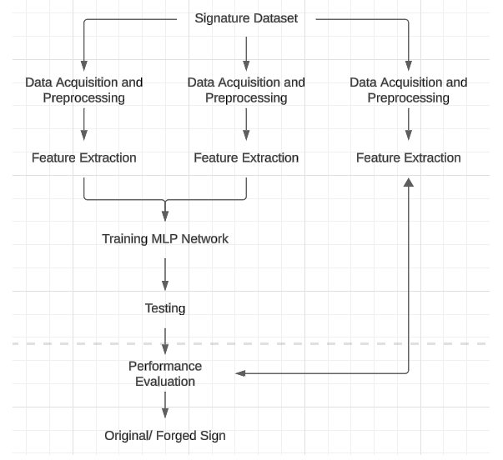
Architecture Diagram

Slide 8
Data Set Description
CEDAR Dataset
CEDAR Signature is a database of off-line signatures for signature verification.
Each of 55 individuals contributed 24 signatures thereby creating 1,320 genuine signatures.
Some were asked to forge three other writers’ signatures, eight times per subject, thus creating 1,320 forgeries.
Each signature was scanned at 300 dpi gray-scale and binarized using a gray-scale histogram.
The database has 24 genuines and 24 forgeries available for each writer.

Slide 9
Module List
Data cleaning and preprocessing
Feature Extraction
Model Training
Model Evaluation
Rating accuracy of a signature

Slide 10
Module Description
Data cleaning and preprocessing
This module cleans the data in the dataset, using techniques like removing converting the images to grayscale and then to binary. It also splits the data into training and testing data.
Feature Extraction
This module standardizes and normalises independent variables to the same scale and calculates factors like skewness and kurtosis.

Slide 11
Module Description
Model Training
This module trains the CEDAR dataset using a MultiLayer Perceptron model in TensorFlow
Model Evaluation
The model is evaluated using techniques like accuracy, error rate, and ROC curve
Rating accuracy of a signature
If the accuracy rating is very low the signature is classified as a forgery

Slide 12
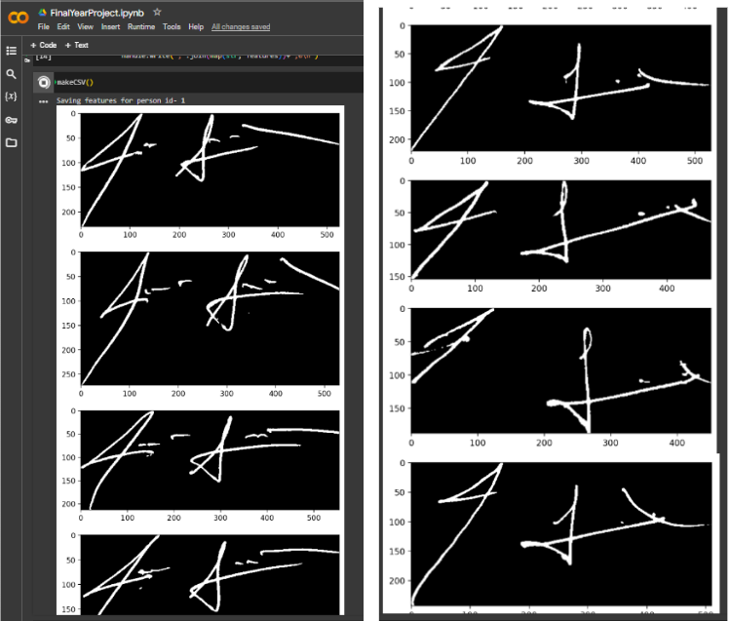
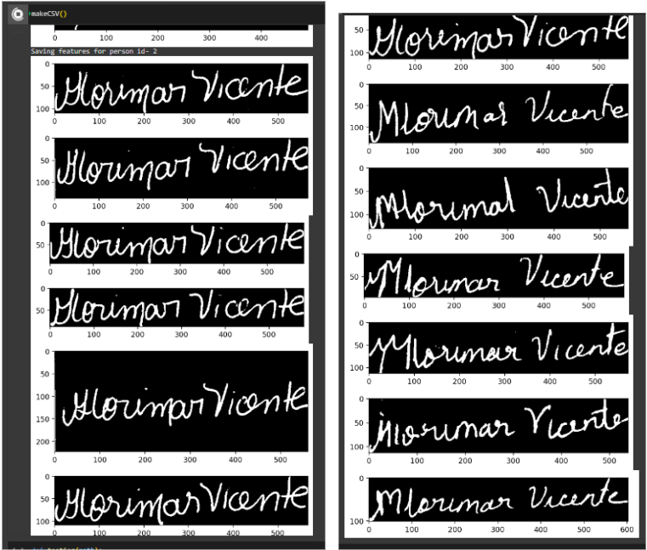
Result and Discussion

Slide 13
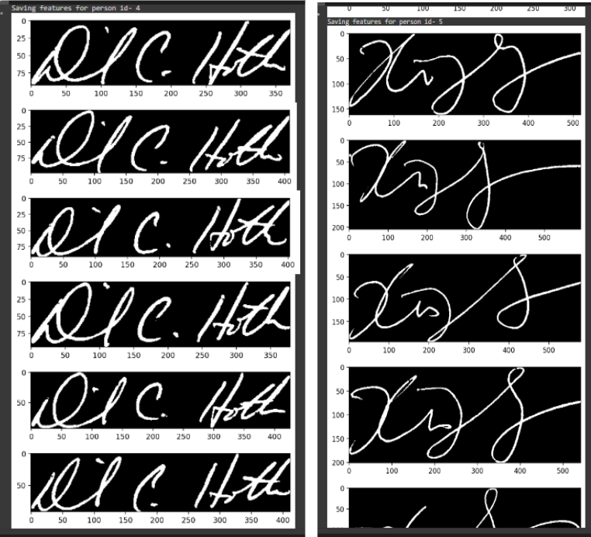
Result and Discussion
After preprocessing and feature extraction is complete, all the features are collected and consolidated into a single CSV file. When make.csv() is run, the following outputs are produced as each signature is preprocessed and converted to a binary image against a black background.

Slide 14
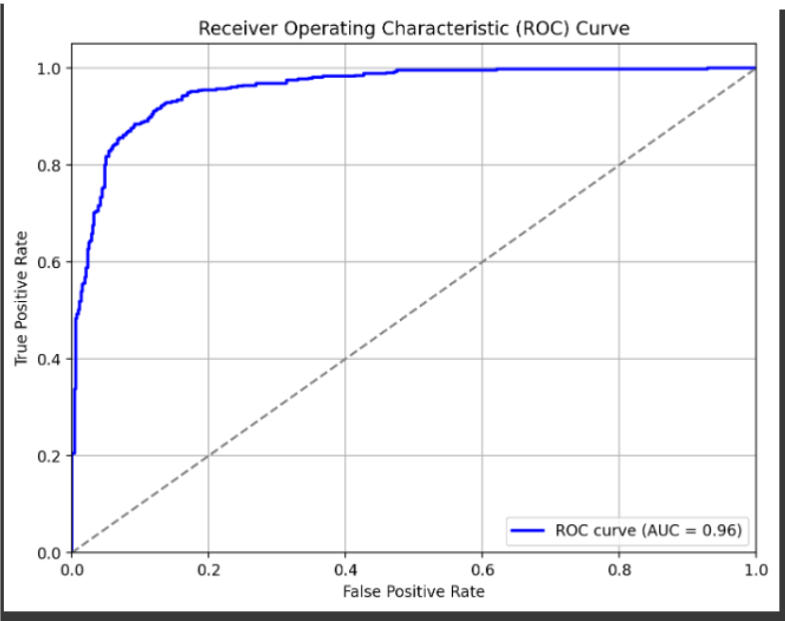
Result and Discussion
The ROC curve is a graphical representation that shows the performance of a binary classification model across different decision thresholds. It plots the True Positive Rate (TPR) against the False Positive Rate (FPR) for various threshold values.
An AUC closer to 1 indicates better performance. An AUC of 0.96 suggests that the model has a high ability to distinguish between positive and negative instances. It means that the model correctly classifies observations into categories with a high degree of accuracy.

Slide 15
Conclusion
In this project, we have proposed and implemented a signature forgery detection system using a Multi Layer Perceptron (MLP). We have trained and tested our model on a large dataset of genuine and forged signatures, and achieved high accuracy and robustness. Our system can be used to verify the authenticity of signatures in various applications, such as banking, legal, and security domains. We have also discussed the limitations and future directions of our work.

Slide 16
Future Enhancement
Ensemble Methods: Implement ensemble methods, such as bagging or boosting, to combine multiple MLP models for improved performance and robustness in signature verification.
Adaptive Learning Rates: Experiment with adaptive learning rate algorithms, such as AdaGrad, RMSProp, or Adam, to dynamically adjust the learning rate during training, potentially leading to faster convergence and better performance.
Integration with Biometric Systems: Integrate the signature verification system with other biometric authentication systems, such as fingerprint or facial recognition, to enhance security and reliability.

Slide 17
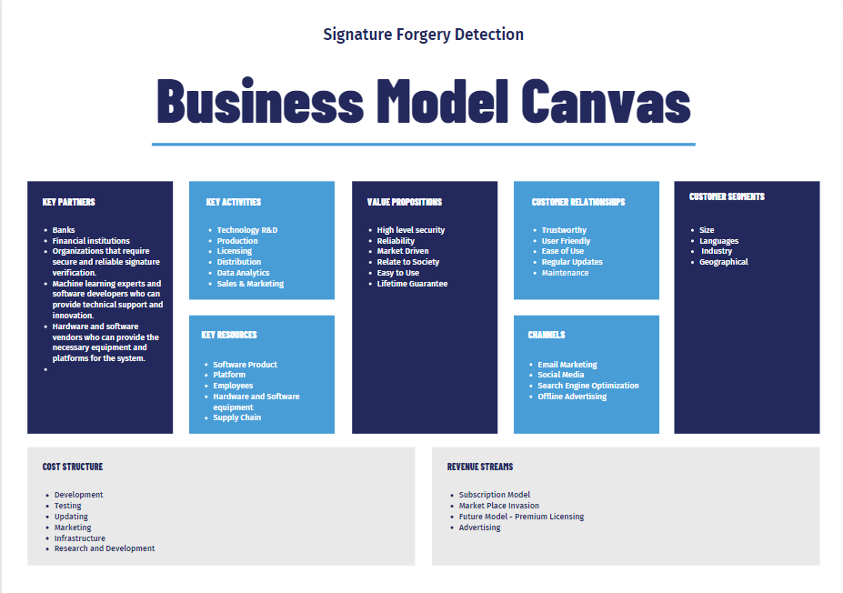
Business Model Canvas

Slide 18
PUblication List
8th Student’s Conference on Engineering and Systems - SCES’24
International Conference on Science and Innovative Engineering - 14 ICSIE 2024
International Conference on Emerging Trends in Engineering and Technology - ICETET 2024.

Slide 19
Reference
https://indiankanoon.org/search/?formInput=forged%20signature+doctypes:judgments
http://bth.diva-portal.org/smash/get/diva2:1753789/FULLTEXT01.pdf
IEEE Xplore
Google Scholar

Slide 20
Thank You
Project Review
‹#›

